Slide 1


Analysis of TED Talks
Anushik Malkhasyan
En-ning Chiang
Hazel Nguyen
Himani Desai
Mridula Singhal
Suwara Thianrungrot
Yao Xiao

Slide 2
TED Ideas Worth Spreading
TED is a nonprofit organization dedicated to spreading ideas in the form of short and powerful talks. As a conference TED started in 1984 by converging Design, Entertainment and Technology. However, today it covers from science to global issues. Additionally, TEDx which runs independently helps share the ideas around the world.
TED’s mission: Spread ideas
TED is a global community that welcomes people from every culture and discipline seeking a deeper acknowledgement of the world. TED believes in the power of ideas to change attitudes, lives and, ultimately, the world. They build a clearinghouse of free knowledge from the world's most inspired thinkers and a community of curious souls to engage with ideas and each other, both online and at TED and TEDx events around the world. TED’s agenda is to make great ideas accessible and spark conversation.

Slide 3
Business Problem
TED is one of the top organization which influences and sparks the ideas across the world. Hence, we would like to evaluate an overall performance of the TED Talks. We use three KPIs:
Engagement: The viewers’ reaction to the talks through comments/ratings
Views: The audience’s interest to the talks based on the views
Speaker’s occupations: Background of the speakers who attracted the most audience
This analysis will help decide which factors lead to the success of the TED talks. This also helps organization understand which topics and speakers would attract the audience. Lastly, the sponsors of the events can use this dashboard to predict the performance of future TED events.

Slide 4
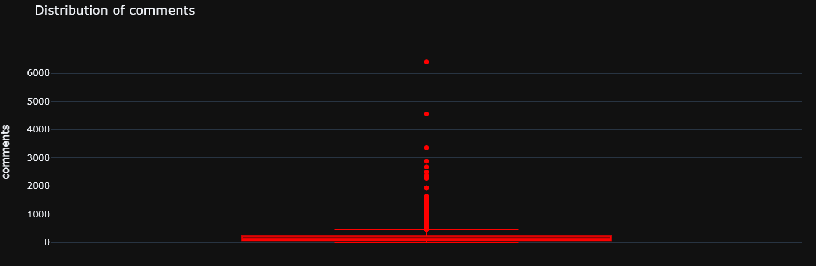
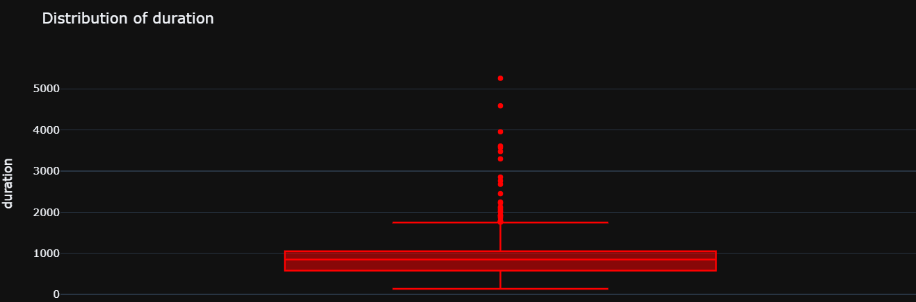
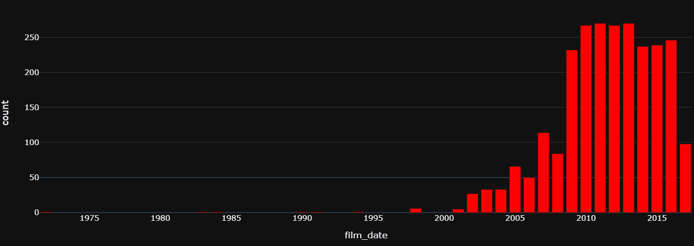
EDA
The raw data we used for the analysis doesn’t have any NULL or NA value.
By analyzing the comments, the duration and the number of the events we see that there are outliers in the data
Since 2002 TED Talks activity/events increased; thus, our analysis are based on the data after 2002 (included)

Slide 5
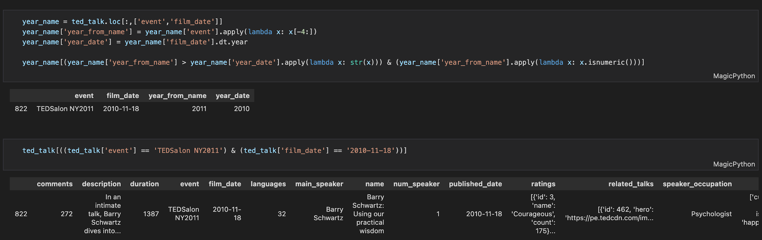
EDA
There is a record that event’s name does not align with film date – event’s name is 2011 but the timestamp is 2010. We examined this data and decided to exclude it from our analysis.

Slide 6
Overall TED Performance
Over 16 years (2002 - 2017) of TED, there are 347 talks that spread ideas to the world
Over 1 million views per talk
TED bring more than 1.4k discussion in each talk

Slide 7
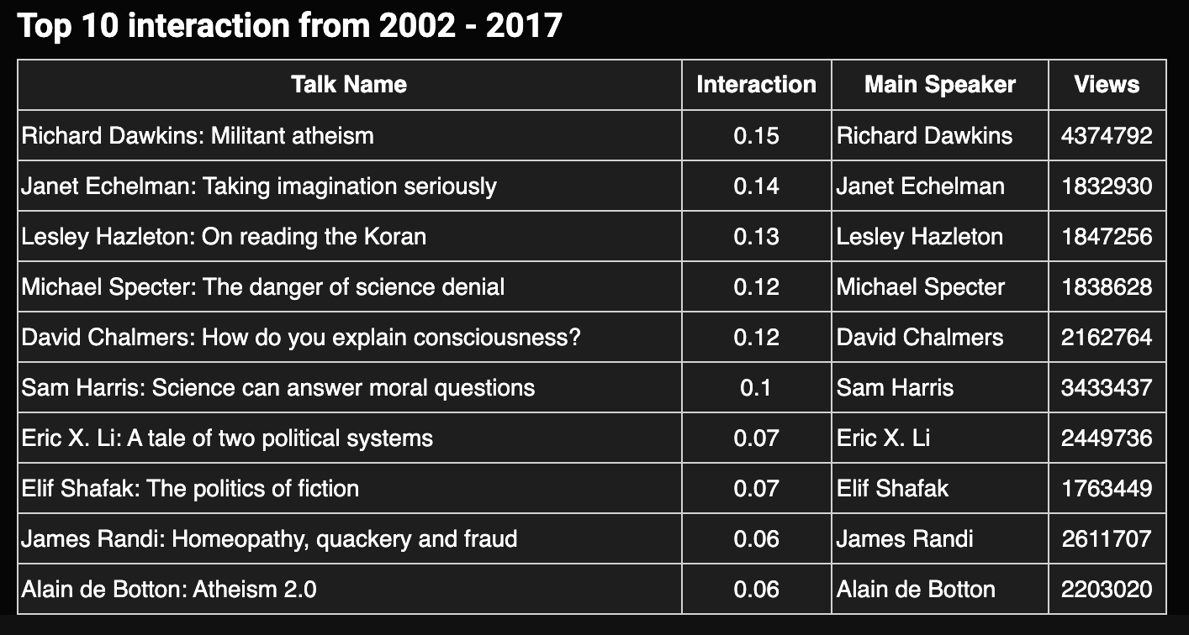
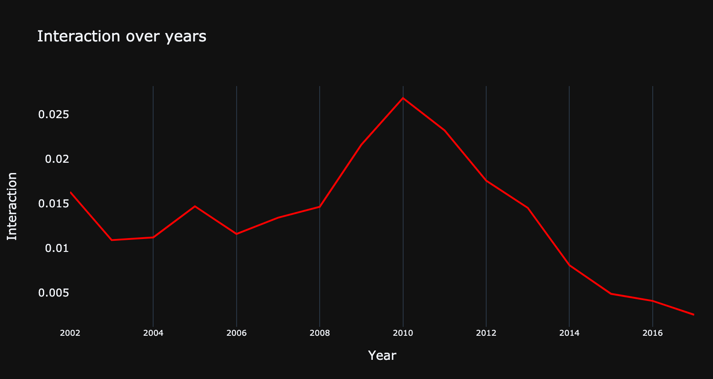
Interaction Over the Years
The table shows the top ten interactions within the TED Talks data over the 16 years in descending order. The talk of Richard Dawkins about Militant Atheism is leading the list with 0.15% interactions.
The line chart shows the TED Talks interactions over the years. The peak of the average interactions was in 2010 with 0.027 interactions. However, after the 2010 the number of interactions decline.

Slide 8
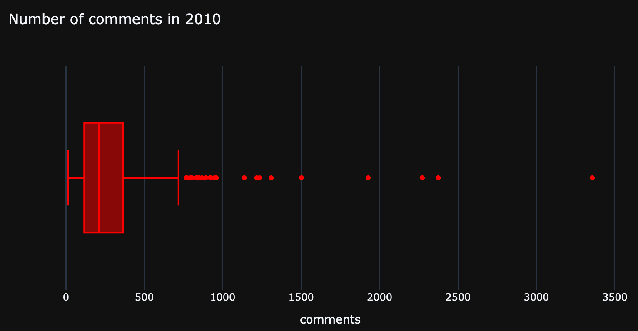
Percentage of Comments and Most Used words in 2010 Talks
There are many outliers in this chart. This means that some talks have far more comments than others.
The median of the number of comments in 2010 is 211
The max is 3356 comments and the min is 15 comments

Slide 9
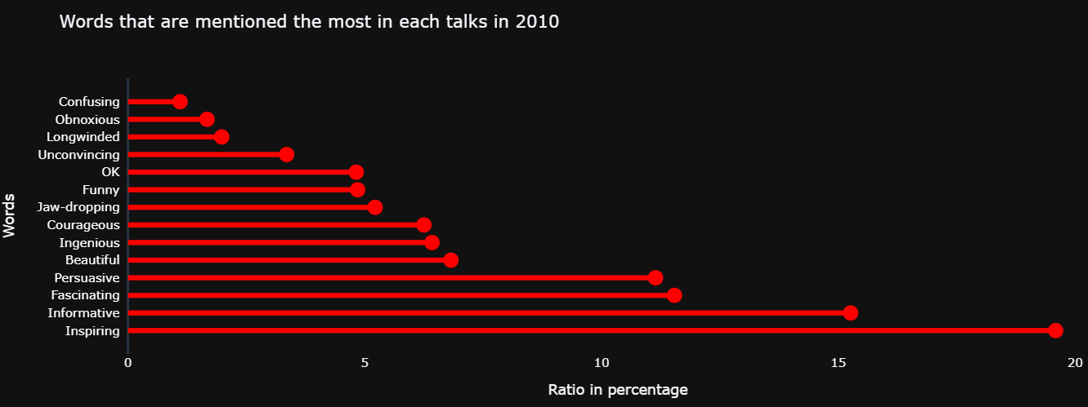
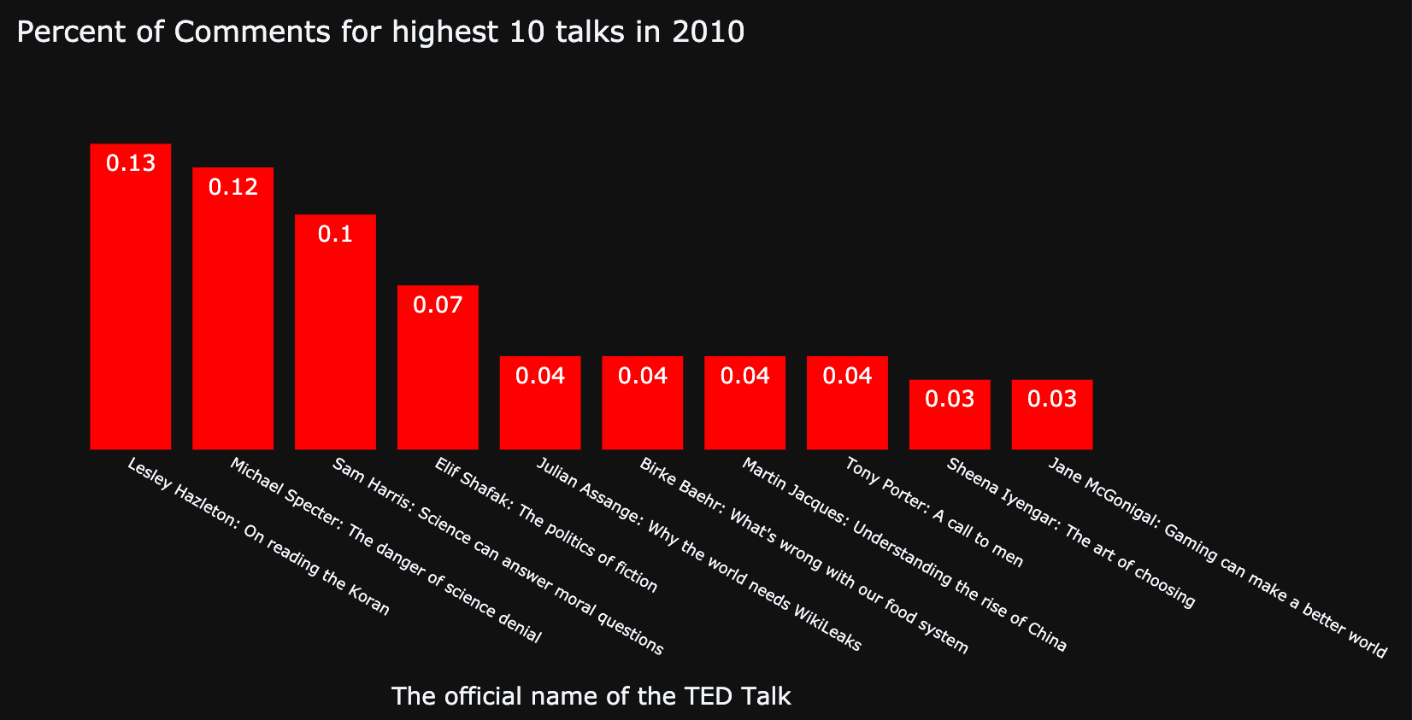
Percentage of Comments and Most Used words in 2010 Talks
Each TED Talk has words associated to the topic of the talk. Inspiring is the word used most often in the talks describing the topic. “Confusing” was the least used word in 2010 for the events’ description.
Lesley Hazleton’s talk regarding “On Reading the Koran” has the highest percentage of comments (13%) in 2010 among the top ten talks.

Slide 10
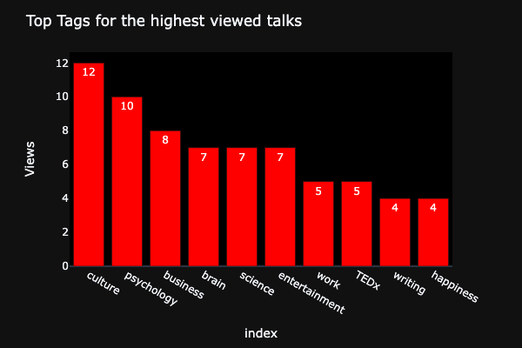
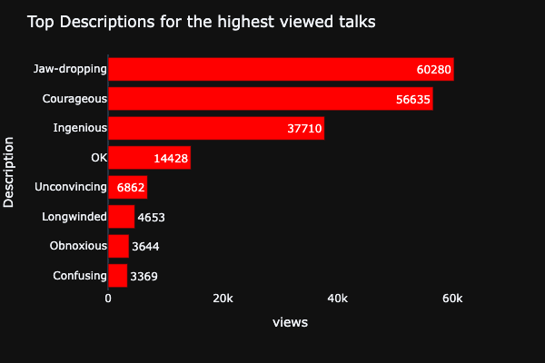
Top Descriptions for the Highest Viewed Talks
Sorted Talks that are top 30 views and normalized value counts for Tags
Converted str to list and created rating list for Ratings
Culture, Psychology, and Business are top three tags for the highest viewed Talks
Jaw-Dropping, Courageous, and Ingenious are top Descriptions for the highest views Talks

Slide 11
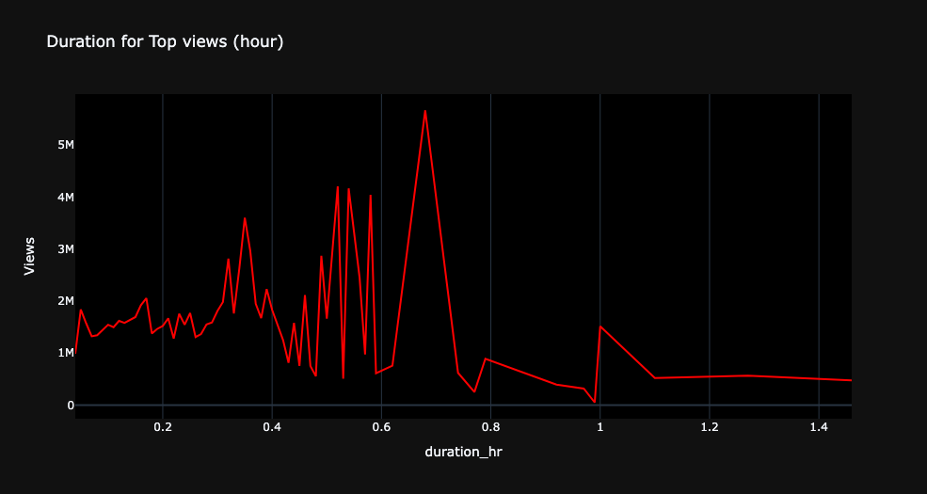
Duration (Hour) for Top Views
Videos with duration around 0.5-0.8 hour have the highest view counts
We would recommend presenters limit the length of their talks to be between 0.5 and 0.8 hours

Slide 12
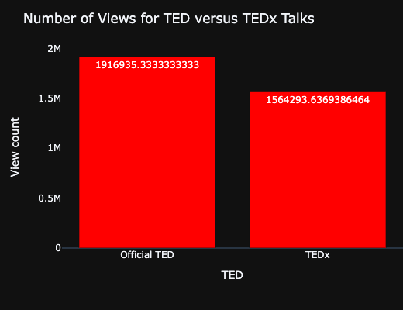
Number of Views for TED vs. TEDx
Official TED Talks have more view count compared to TEDx.

Slide 13
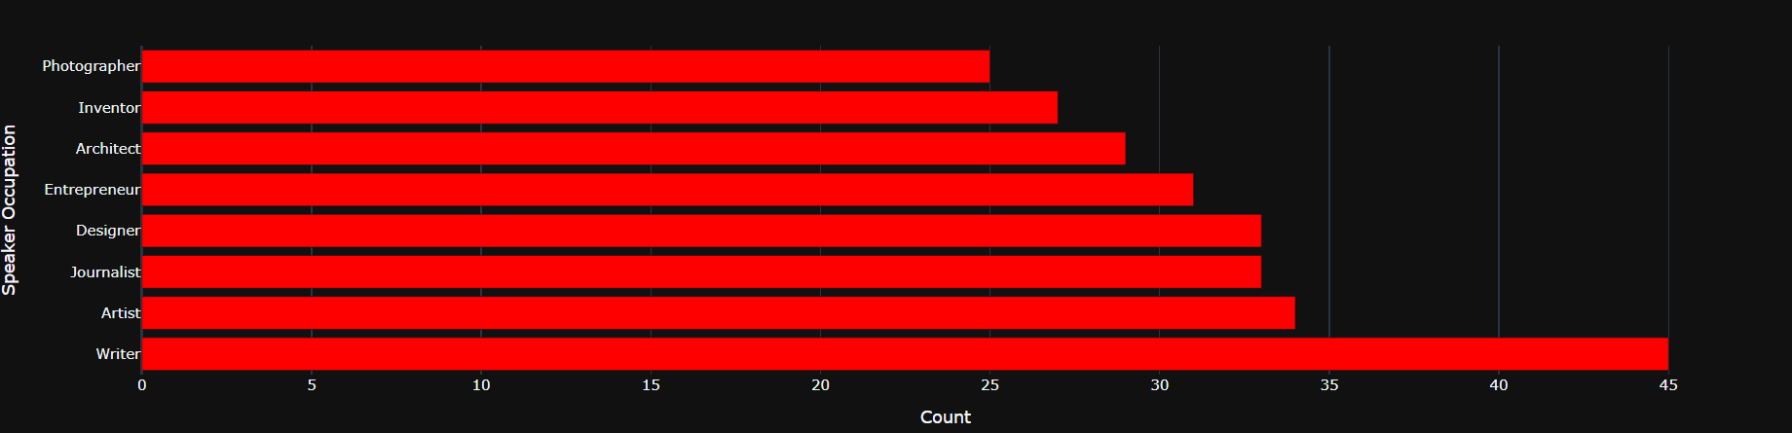
Top 8 Occupations with Number of Talks
The bar chart depicts the top 8 occupations(By number of Ted talks)
‘Writer’ with a count of 45 has the highest number of Ted talks amongst all the occupations in the dataset

Slide 14
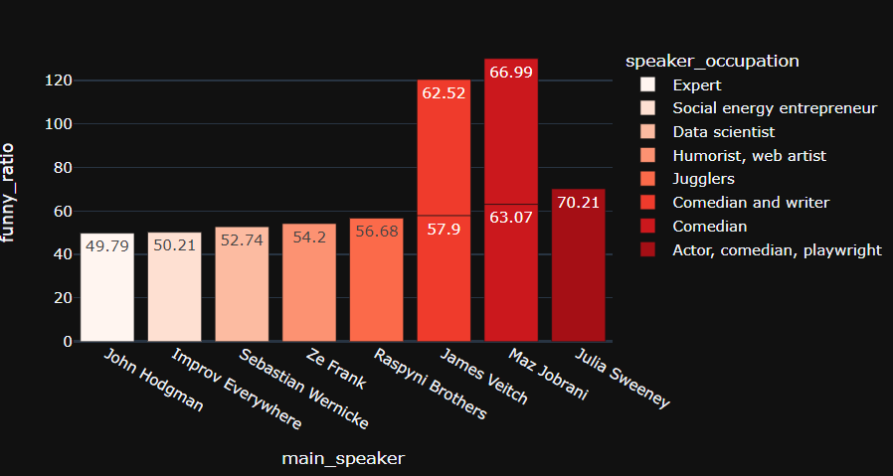
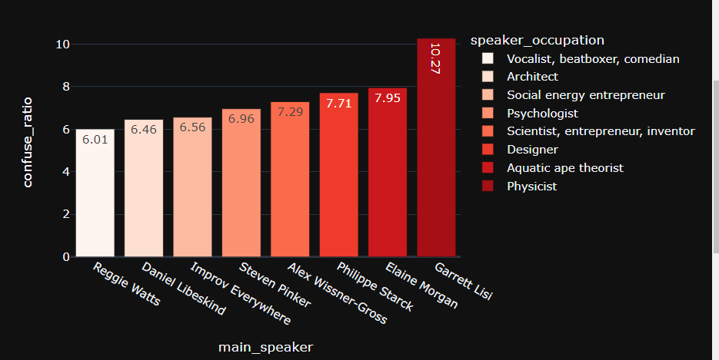
Top Ted Talks by
Funny Ratio and their Occupation
Confusing Ratio and their Occupation
Speaker Julius Sweetney, who is an Actor, Comedian and Playwright by profession has the highest Funny Ratio
Speaker Garrett Lisi, whose occupation is that of a Physicist has the highest confusing Ted talk ratio

Slide 15
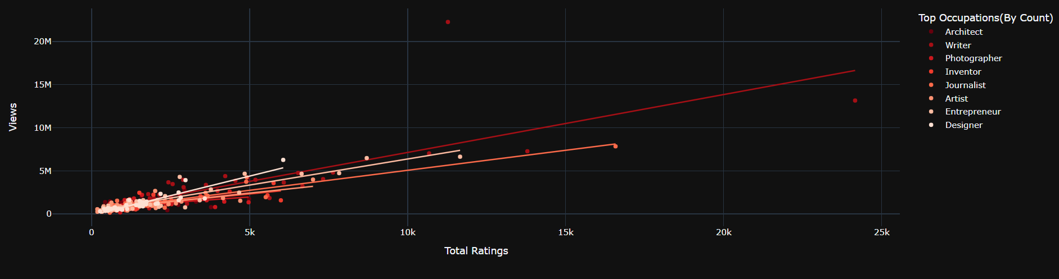
Regression Plot of Views vs Ratings
The above visualization is a graphical demonstration of a regression plot of Views Vs. Ratings for top 8 Occupations (By Count of Ratings)
An interesting finding is that the Occupation category of Journalist has the highest R² amongst the trendlines of all the occupations and denotes that about 88.44% of the given data fits in the regression model.
Conversely, Photographer had the lowest R² amongst all and only about 33.54% of the data fits in the regression model.

Slide 16
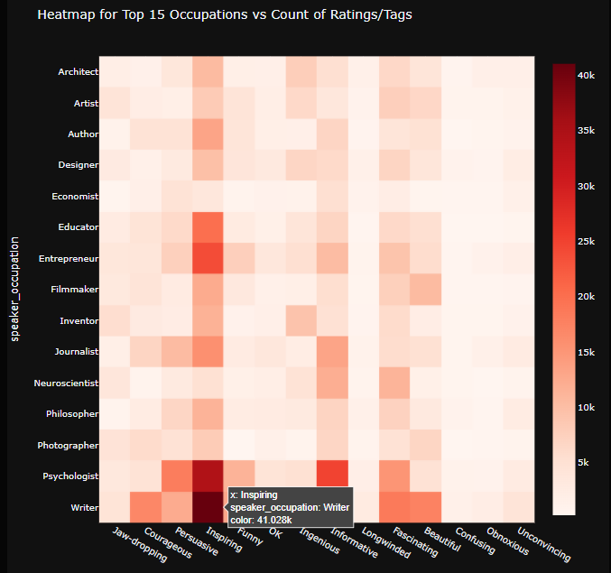
Top 15 Occupations vs. Count of Rating/Tags
The heatmap gives an overview of which tags are used more often in which occupations
For example, As interesting insight would be the tag ‘Inspiring’ been used the most for a Writer, the count of the tag being more than 41k

Slide 17
References
https://www.ted.com/
https://www.kaggle.com/rounakbanik/ted-talks
https://plotly.com/dash/

Slide 18
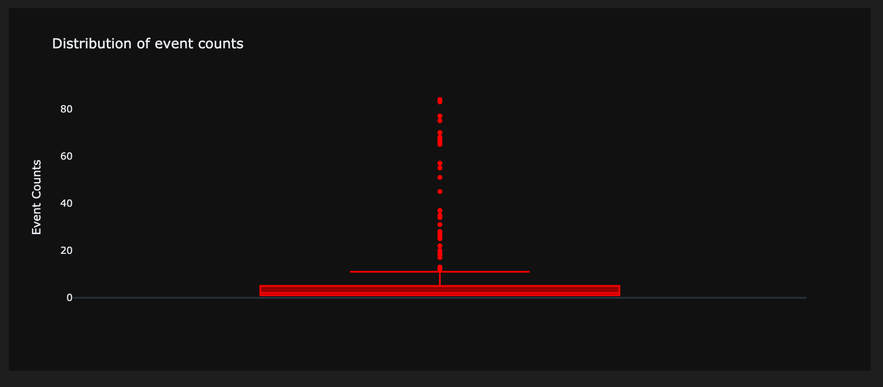
Appendices

Slide 19
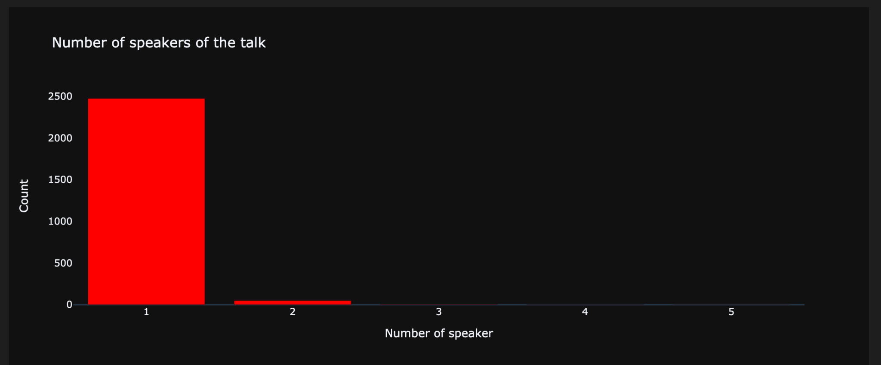
Appendices

Slide 20
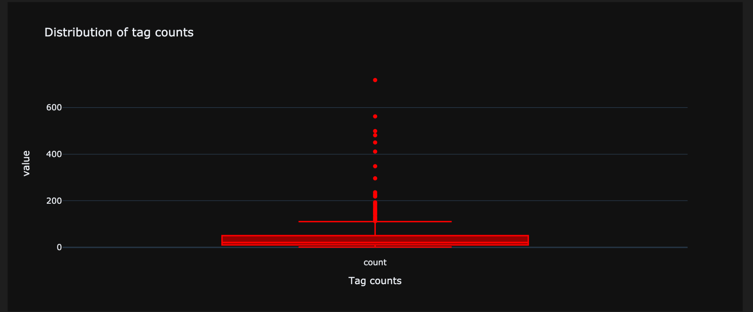
Appendices

Slide 21
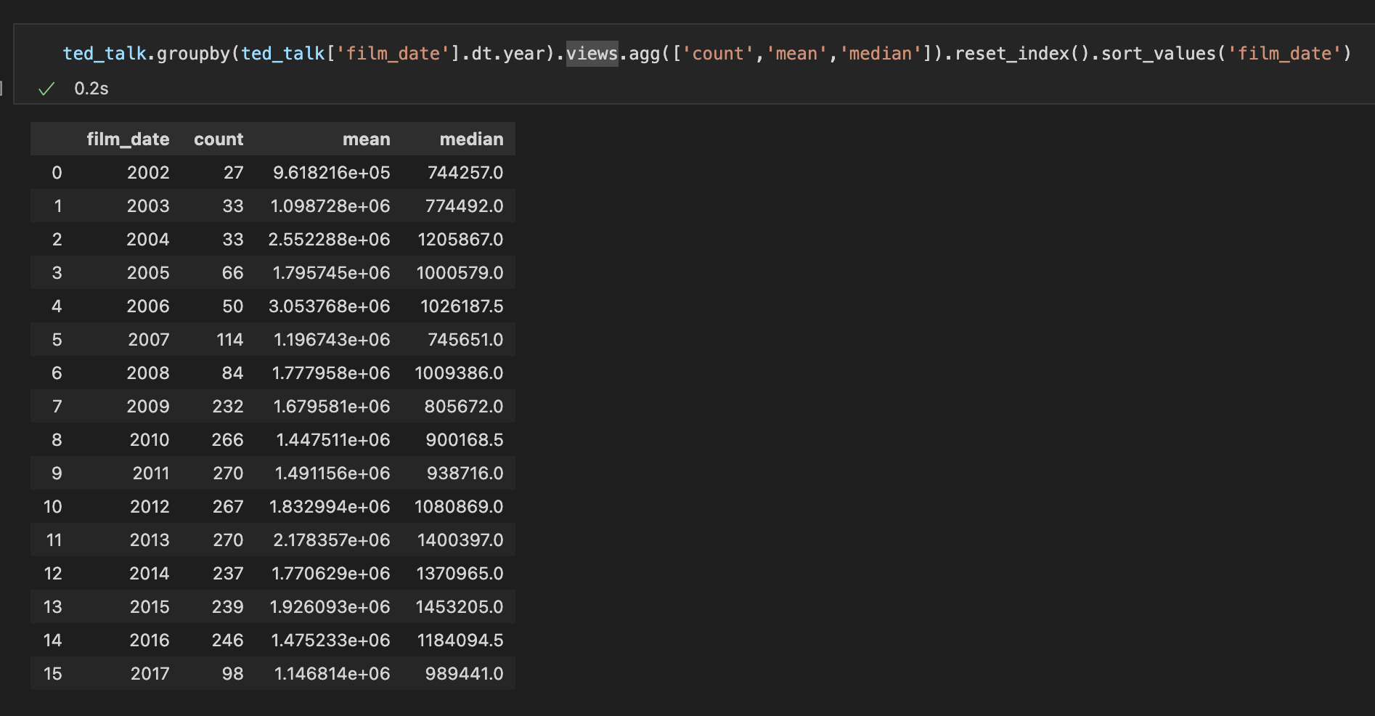
Appendices
Count, mean, and median of views in each year

Slide 22
THANK YOU

